Slide 1


WOMEN SAFETY
If women feel safe wherever and whenever they are, the world will be a safer place.

Slide 2
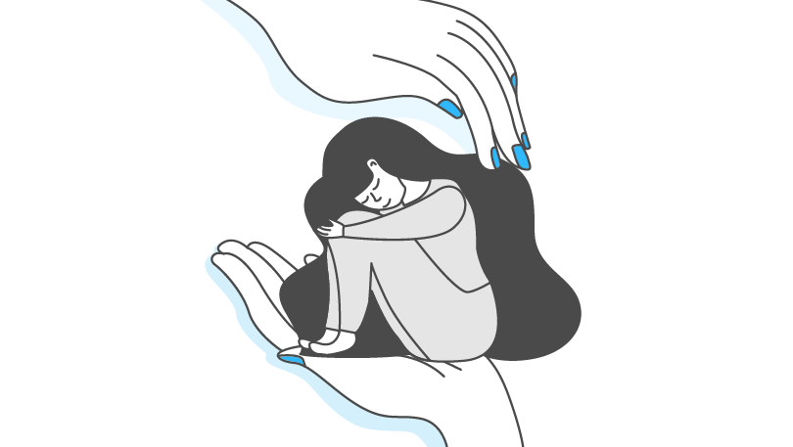
Definition
We desire that the ladies in our nation feel secure.
Women in our country should be treated with respect since they are constantly working to make the world a better place.

Slide 3
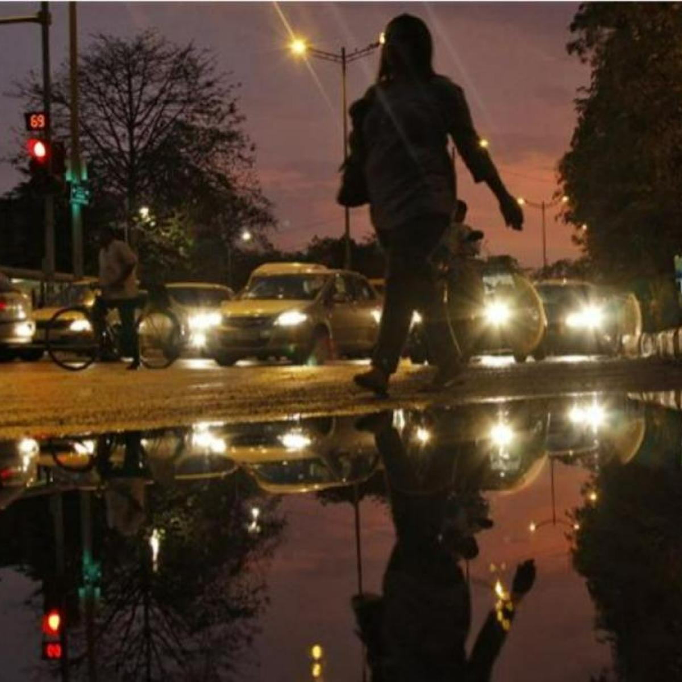
PROBLEMS OF WOMEN
Our women leave home during the day and go far away after finishing their work and return home.
75% women in our country return home after working at night.
When the women return home, some may face some difficulties on the way.
Even if they try to ask others for help with new tools, those tools may fail due to the subtlety of those humans.

Slide 4

TYPE OF ARREST
Physical
Sexual

Slide 5

Women safety Tools
The intricacies of those males may ultimately render new tools for women in our world useless.
When women are in desperate situations, anything can happen before they can use the life-saving tools at hand.

Slide 6
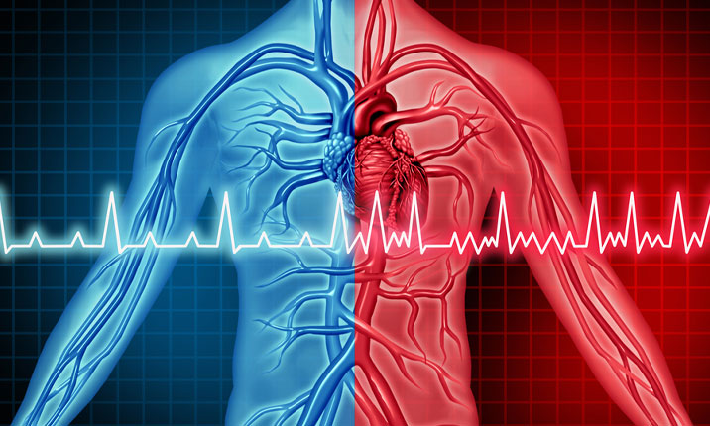
HEART BEAT RANGE
An average woman's heart rate is 77.6 beats per minute. 60 to 100 beats per minute during exercise and any work
When a woman is afraid of something her heart rate increases by 41.9%over normal to 110.1 beats per minute.

Slide 7
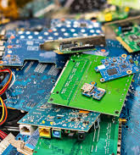
COMPONENTS
ARDUNIO UNO
HEART BEAT RATING SENSOR
GSM MODULE
BATTERY CHARING MODULE
VOICE TRANSMITTING
SECRET MINI CAMERA TRANSMITTING
LITHIUM BATTERY

Slide 8
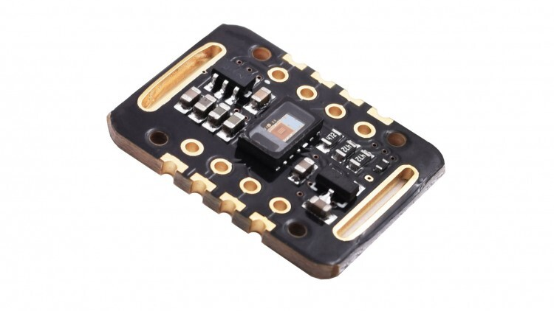
HEART BEAT SENSOR
This sensor monitors the average heart rate.
This sensor works like any other heart rate monitor ,But
When the pulse rate rises above the average heart rate or increases to 110 beats per minute, this sensor starts working.

Slide 9
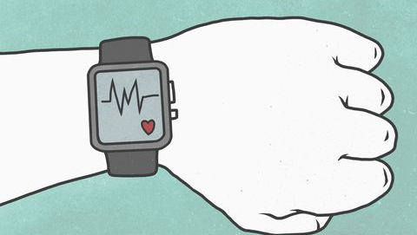
WORKING
This sensor monitors the constant pulse rate of the blood and also works when the rate increases.
When the heart rate rises, it will automatically send the voice recording to the official headquarters within five seconds and within the next five seconds, the video surveillance recording will be sent to the official headquarters.
Their location will be transmitted to the official command center through the GSM module in the next five seconds

Slide 10
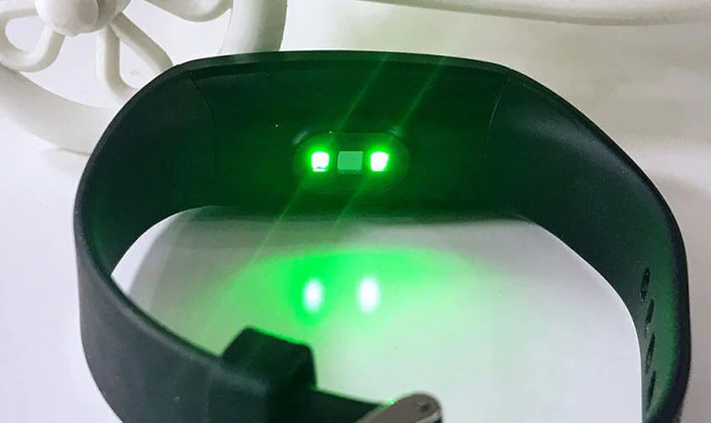
MODEL IMAGE

Slide 11

BENEFITS
Through this project the lives of innocent women can be saved from some human beings
With this, if there are any problems in humans, it can be easily diagnosed with the help of this tool.

Slide 12


